Slide 1
Reflex activated
Fast reflex (0.02s)
Input
The RL agent acting in a real time environment is augmented with a reflex loop consisting of three neurons.
The reflex activates when the angle of the inverted pendulum is near failure.
The response time of the reflex is 20ms after receiving an input while the response time of the neural network is 80ms.
Action (0.08s)
Performance with reflex: 122.25 seconds survived
Performance without reflex: 111.80 seconds survived

Slide 2
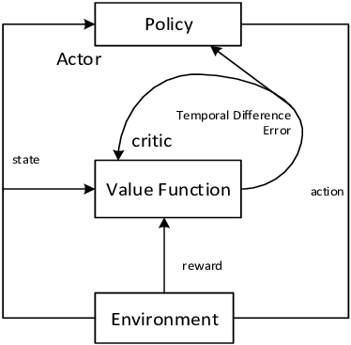
Automatic time slicing using dopamine
Problem setting: We have four different policies available for the same task and what to reduce the number of actions picked/ forward passes while maintaining the accuracy of the fastest response time.
Proposed method:
Train four networks with different response times using actor critic:
After training, let the actor choose from all four networks
Depending on the TD error based on the critic from the fastest
Network.
A low TD error means that the actions being performed are
near optimal and thus cause boredom resulting in actor picking coarser actions.
A high TD error means that the actions being performed are not optimal and the actor would benefit
from picking faster response resulting in finer control.
Actor
Network 1
20ms
Network 2
40ms
Network 3
80ms
Network 4
160ms
TD Error low
TD Error high
Critic (from 20ms network)
Value Function
TD Error
Near optimal
Environment

Slide 3
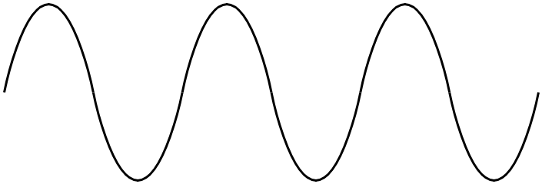
actor
Policy
TD Error
critic
Value function
action
state
reward
Environment
actor
Fast
Slow
Dopamine High
Dopamine Low
critic
state
Value function
action
reward
Environment

Slide 4
 | Seconds survived (Decisions made)
Res. speed | 0.16s | 0.08s | 0.04 | 0.02 | 0.01
w/o Reflex | 83.81 (534) | 109.21 (1366) | 127.8 (3195) | 152.68 (7634) | 138.4 (13840)
With Reflex | 107.72 (674) | 129.14 (1618) | 132.23 (3306) | 159.63 (7982)

Slide 5
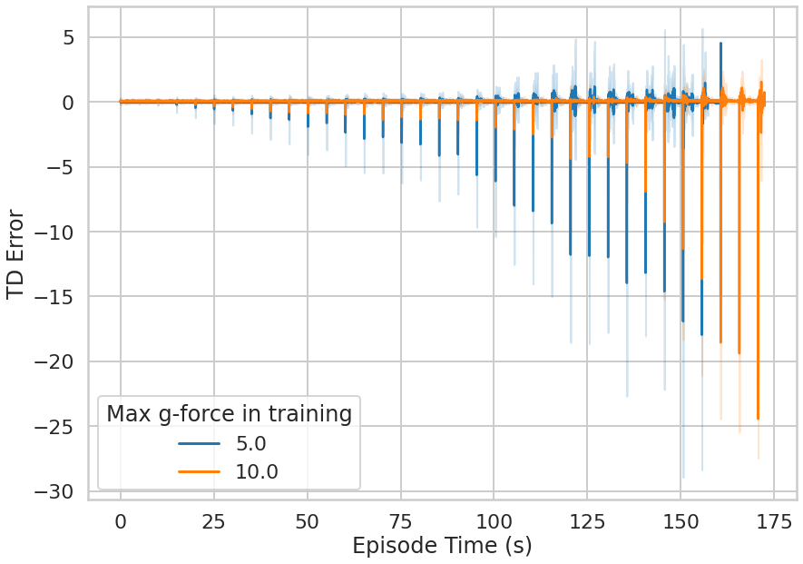

Slide 6
Actor (slow A⁰)
Actor (Fast A¹)
TD⁰
TD¹
A⁰
+
A¹
Critic (slow)
Critic (Fast)
Compound action
State
reward
Environment
Action

